Slide 1
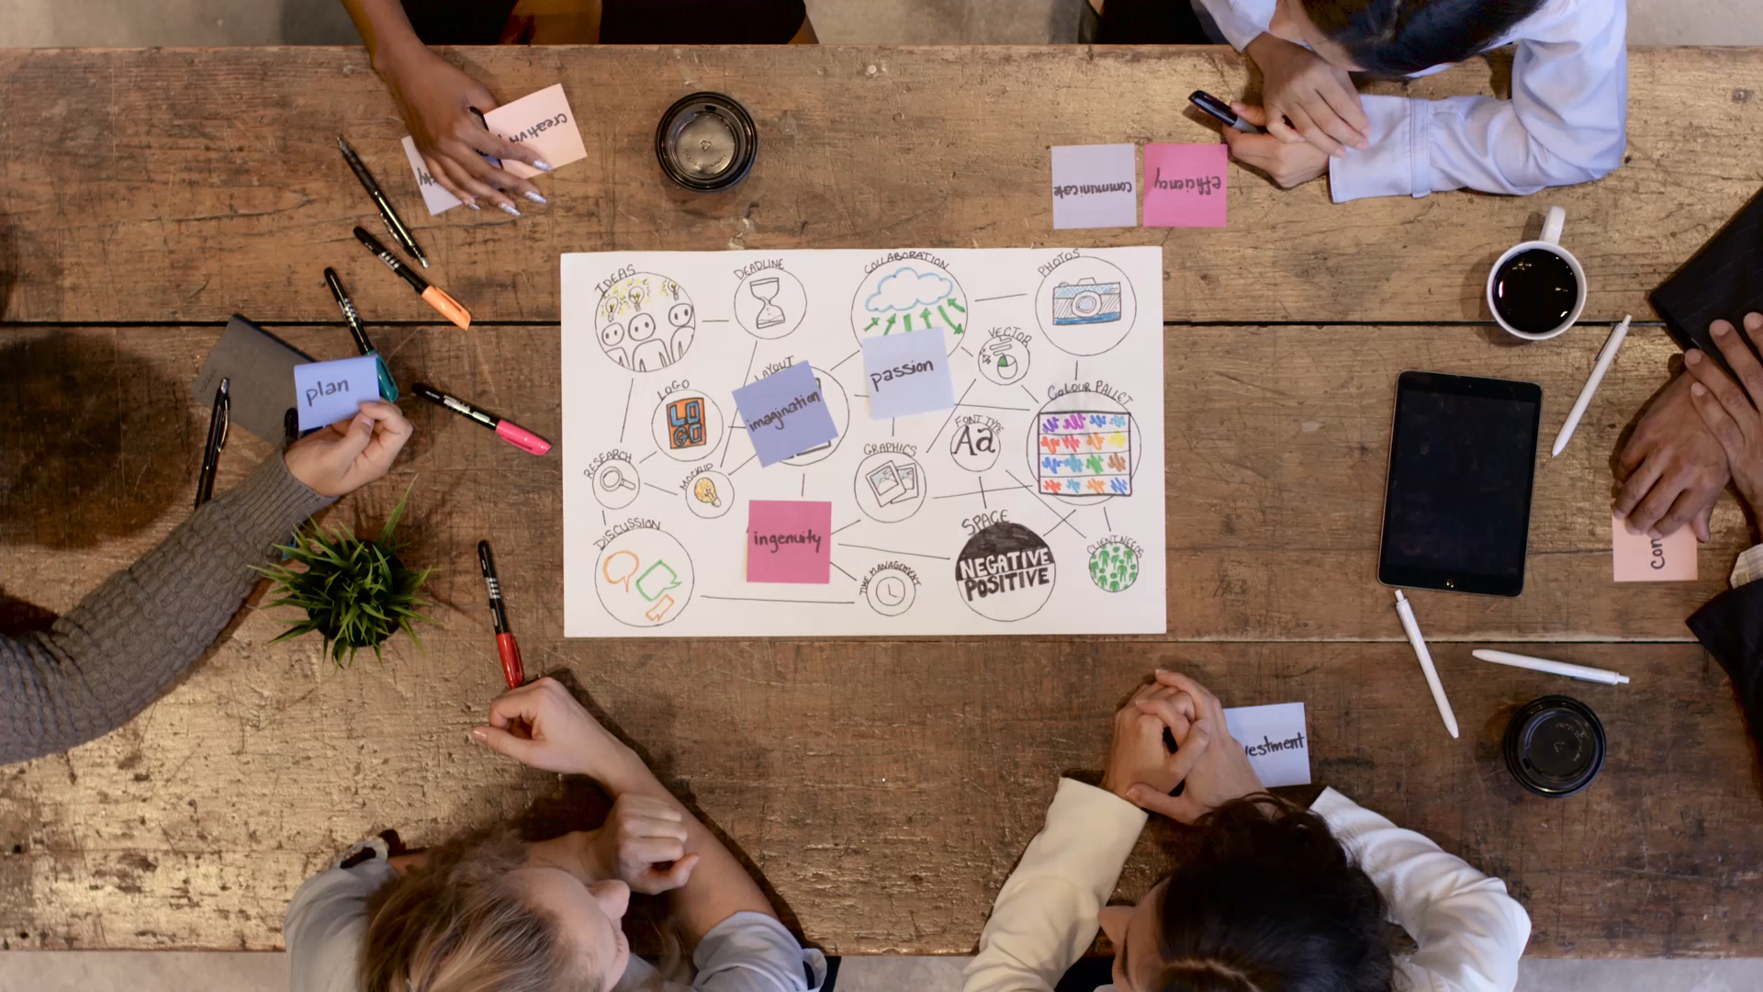
Navigating the Digital Landscape: Teamwork in Software Engineering
By: Michael Connell

Slide 2

Essential Traits of Software Engineers
Problem-Solving: Engineers must navigate complex algorithms and systems, akin to solving a labyrinth of code.
Attention to Detail: Overlooking even the smallest error can lead to a cascade of bugs, much like a misstep in a minefield.
Effective Communication: It's the bridge that connects isolated islands of expertise in a tech team.
Adaptability: The digital landscape is ever-shifting, demanding agility like a surfer riding the waves of change.
Continuous Learning: Keeping up with new languages and frameworks is as crucial as a scout staying ahead of the wasteland's dangers.
These traits are not just skills but survival tools in the wilds of software development, where each project can be a journey through uncharted territories.
Notes:
1-Begin with the analogy of software engineers needing to navigate complex systems and compare this to solving a code labyrinth.
2-Emphasize the importance of attention to detail by relating it to avoiding bugs, much like avoiding missteps in a minefield.
3-Highlight effective communication as a crucial bridge between different areas of expertise within a team.
4-Discuss adaptability in the context of the fast-evolving tech environment and continuous learning as an ongoing requirement.

Slide 3

Communication Breakdowns: Real-World Challenges
The Ambiguous Specs: Misinterpreted requirements due to vague communication led to a flawed feature implementation, setting the project back by weeks.
The Overlooked Bug: A critical bug was not reported by a junior developer, resulting in a costly system failure at launch.
The Marketing Mix-Up: Poor interdepartmental communication caused a product's capabilities to be incorrectly marketed, damaging the company's credibility.
Notes:
1-Illustrate the detrimental impact of vague communication with the example of 'The Ambiguous Specs’.
2-Discuss the consequences of overlooked details with 'The Overlooked Bug’.
3-Explain the wider implications on a company's credibility with 'The Marketing Mix-Up’.
4-Conclude with the key takeaways emphasizing the importance of precise communication, sharing insights, and cohesive messaging.

Slide 4
Key Takeaways:
Precise communication is crucial to align team efforts with project goals.
Encouraging a culture where all team members actively share insights and concerns.
Cross-functional communication is key to ensuring cohesive external messaging.

Slide 5

Building Your team: The Power of Teamwork
Diverse Perspectives: A mix of backgrounds and specialties fuels innovation, much like a well-rounded party can tackle any quest.
Strength in Numbers: Collaborative problem-solving leads to more robust solutions, echoing the idea that 'many hands make light work.
Shared Goals: United by a common mission, teams can move mountains—or at least, hefty codebases—with greater efficiency.
Support System: A supportive team can weather any storm, be it tight deadlines or daunting bug hunts, with each member playing a vital role.
Notes:
1-Begin by highlighting the value of diverse perspectives and compare the team to a well-rounded RPG party.
2-Talk about the concept of 'Strength in Numbers' and how collaborative efforts can lead to robust solutions.
3-Stress the importance of shared goals in moving projects forward efficiently.
4-Finish with key takeaways on the amplification of individual capabilities through teamwork and the significance of a collaborative culture.

Slide 6
Key Takeaways:
Harnessing the power of teamwork amplifies individual capabilities and drives projects to success.
Fostering a culture of collaboration and mutual support is essential in the fast-paced world of technology.
The whole is greater than the sum of its parts; together, a team can achieve what individuals alone cannot.

Slide 7

Assembling Your Crew: Roles and Responsibilities
Project Manager: The navigator who charts the course, keeping the project on time and budget.
Product Owner: The visionary who ensures the product meets the market's needs and user expectations.
Development Team: The builders, each a specialist in their own right, from architects (senior developers) to apprentices (junior developers), crafting the code that brings the vision to life.
Quality Assurance (QA) Engineers: The sentinels who guard against bugs and ensure the product's reliability through rigorous testing.
UI/UX Designers: The artists who design the product's interface, ensuring it is both aesthetically pleasing and user-friendly.
Technical Writers: The scribes who document the journey, providing clear instructions and help materials for users and maintainers alike.
Notes:
1-Introduction: Begin by highlighting the importance of having a diverse and skilled team in software engineering. Each role is crucial for the success of a project, much like characters in a well-balanced adventure party.
2-Project Manager: Explain how the project manager acts as the team's navigator, keeping the project aligned with its goals and ensuring it stays on schedule and within budget.
3-Product Owner: Discuss the role of the product owner as the visionary who ensures the product meets market needs and user expectations. Emphasize their role in maintaining the project's vision and direction.
4-Development Team: Describe the development team's composition, from senior developers (architects) to junior developers (apprentices). Highlight their expertise in transforming concepts into functional code.
5-Quality Assurance Engineers: Talk about the critical role of QA engineers in maintaining product quality. They are like sentinels, ensuring that the final product is bug-free and reliable through rigorous testing.
6-UI/UX Designers: Mention how UI/UX designers are the artists of the team, focusing on the aesthetic and user-friendly aspect of the product.
7-Technical Writers: Conclude with the role of technical writers, who document the entire process and provide clear instructions and help materials for users and maintainers, ensuring that the product is not just functional but also accessible.
8-Closing: Emphasize the interdependence of these roles and how they all contribute to the successful completion of a software project.

Slide 8
Key Takeaways:
A successful team is well-rounded, with clear roles and responsibilities that complement each other.
Understanding each role's contributions helps in achieving a harmonious and efficient project development cycle.
Communication and respect between roles are essential for navigating the complexities of software creation.

Slide 9

Pip-Boy for the Modern Age: Collaboration Tools
Communication Channels: Tools like Slack and Microsoft Teams act as the radio transceiver, allowing for seamless and instant team communication and file sharing.
Project Management: Platforms like JIRA and Trello serve as your navigational compass, helping keep track of tasks, sprints, and project progress.
Version Control: GitHub and GitLab are the chronicles of code, enabling version tracking, code review, and collaborative coding.
Continuous Integration/Continuous Deployment (CI/CD): Jenkins and GitLab CI/CD ensure that your software is always ready to deploy, like a trusty multi-tool.
Documentation: GitHub, Confluence and Notion work as your archive, storing valuable project documentation and knowledge in an organized manner.
Notes:
1-Introduction: Start by drawing a parallel between the versatility of a Pip-Boy in the wasteland and how collaboration tools serve a similar multi-functional purpose in software development.
2-Communication Channels: Emphasize the importance of tools like Slack and Microsoft Teams for keeping the team in sync, sharing files, and maintaining fluid communication in real-time.
3-Project Management: Discuss how platforms like JIRA and Trello act as a navigational aid, helping the team visualize progress and manage tasks efficiently.
4-Version Control: Explain the role of GitHub and GitLab in safeguarding the codebase, allowing for historical tracking, peer review, and collaborative contributions.
5-CI/CD: Highlight how Jenkins and GitLab CI/CD automate the software release process, ensuring that software is always in a deployable state and reducing manual deployment efforts.
6-Documentation: Stress the importance of having a single, organized repository for documentation. GitHub, Confluence, and Notion provide a centralized source of information that is crucial for the team's success.
7-Conclusion: Conclude by reinforcing the message that these tools are not just conveniences but necessities in the modern age of software development, streamlining workflows, and fostering a culture of collaboration.

Slide 10
Key Takeaways:
Collaboration tools are the lifelines that keep the digital wasteland navigable, and the team aligned.
Integrating these tools into daily workflows enhances efficiency and creates a cohesive development environment.
Selecting the right tools is essential, as they become the backbone of communication and collaboration in any software project.

Slide 11

Enhancing Your Pip-Boy: Advantages of Collaboration Tools
Streamlined Communication: Like an upgraded radio, these tools ensure clear and instant dialogue across the team, breaking down roadblocks.
Efficient Project Management: They act as your quest log, keeping track of tasks, deadlines, and progress, making sure the team stays on mission.
Version Control Precision: Offers a historical record of the codebase, allowing for time travel to past versions to understand changes and resolve conflicts.
Automated Workflows: Like having a robotic assistant, they automate repetitive tasks, allowing the team to focus on innovation and complex problem-solving.
Centralized Documentation: Provide a single source of truth for project information, preventing the confusion of scattered and outdated documents.
Notes:
1-Introduction: Start with the analogy that just as the Pip-Boy enhances the abilities of a lone wanderer in the wasteland, collaboration tools significantly boost a software team’s productivity and efficiency.
2-Streamlined Communication: Stress how tools like Slack and Microsoft Teams centralize communication, allowing the team to share information and files quickly, keeping everyone on the same page.
3-Project Management Efficiency: Emphasize the advantages of using JIRA and Trello for tracking the progress of tasks and sprints, which help in maintaining the project's direction and focus.
4-Code Management: Talk about the role of GitHub and GitLab in maintaining code integrity, facilitating peer reviews, and fostering an environment for collaborative coding.
5-Deployment Readiness: Highlight how CI/CD tools like Jenkins and GitLab CI/CD automate the deployment process, ensuring the team can deliver continuous updates and maintain service reliability.
6-Knowledge Sharing: Point out the benefits of having a centralized documentation hub using tools like GitHub, Confluence, and Notion, where knowledge is stored, organized, and easily accessible.
7-Conclusion: Conclude by summarizing that these tools not only enhance individual productivity but also fortify the collaborative spirit, ensuring that the team can face and overcome complex development challenges together.

Slide 12
Key Takeaways:
Collaboration tools enhance productivity by optimizing workflow and communication.
They provide transparency in the development process, fostering trust and accountability.
By reducing manual overhead, these tools allow engineers to concentrate on what they do best: creating.

Slide 13
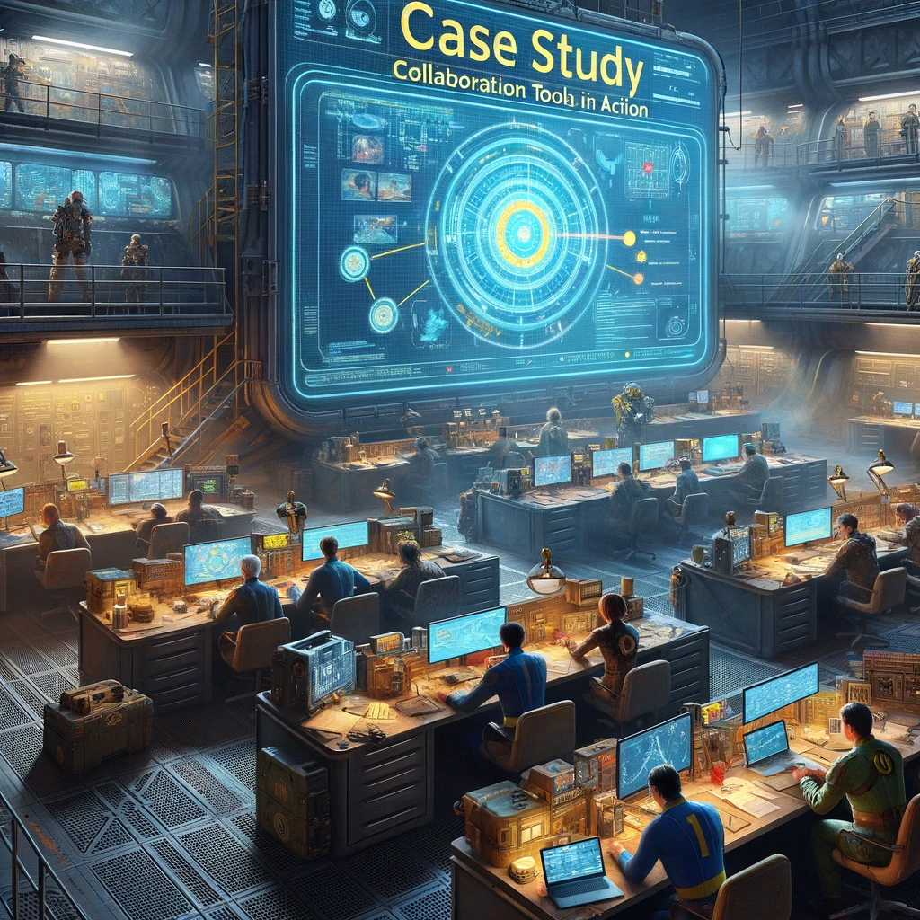
Case Study: Collaboration Tools in Action
Background: A mid-sized software company faced challenges managing its growing team and projects.
Problem: Teams were working in silos, leading to miscommunication, duplicated efforts, and missed deadlines.
Solution: The company implemented a suite of collaboration tools:
Slack for communication, breaking down barriers between departments.
JIRA for project and issue tracking, clarifying tasks and ownership.
Confluence for documentation, centralizing knowledge.
GitHub for version control, streamlining code integration and review.
Jenkins for CI/CD, automating the build and deployment process.
Notes:
1-Introduction: Start by introducing the concept of 'silos' in the workplace, explaining that silos refer to the isolation that occurs when departments or teams don't share information with others in the same organization.
2-Background: Mention the company's struggle with siloed departments, where teams worked independently like isolated towers, hindering collaboration and efficiency.
3-Implementation: Describe how collaboration tools were introduced to break down these silos, fostering cross-departmental communication and cooperation.
4-Results: Highlight the outcomes, emphasizing the improved integration between teams, elimination of redundant efforts, and enhanced project synergy.
5-Analysis: Reflect on how breaking down silos led to a more unified team approach, better problem-solving, and a cohesive company culture.
6-Conclusion: Conclude with a summary of the key benefits of using collaboration tools to overcome the challenges of siloed operations in software development teams.

Slide 14
Outcome & Key Takeaways:
Productivity increased by 30%, with a notable reduction in critical bugs.
Project completion rates improved, with a 25% decrease in time-to-market for new features.
Team satisfaction scores went up as frustration with miscommunication and disorganization decreased.
The strategic use of collaboration tools can significantly improve team efficiency and product quality.
These tools help in establishing a transparent and accountable workflow.
A well-implemented toolset is a game-changer, turning potential chaos into orchestrated success.

Slide 15

Blueprints of the Landscape: Collaborative Planning
Overview:
Collaborative planning is the blueprint for navigating the unpredictable terrain of software projects.
Key Components:
Goal Setting: Defining clear, achievable objectives is like charting a map for a treacherous journey.
Resource Allocation: Like rationing supplies for a long expedition, determining who does what and when is critical.
Risk Assessment: Identifying potential pitfalls ahead of time is akin to scouting for dangers in the new territory.
Timeline Establishment: Setting milestones and deadlines ensures the team stays on track, like following a marked trail.
Notes:
1-Introduction: Begin by emphasizing that collaborative planning serves as the foundation for any successful software project, akin to a blueprint in construction.
2-Goal Setting: Elaborate on the necessity of setting clear, achievable objectives to guide the team's efforts, comparing it to mapping out a path before embarking on a challenging journey.
3-Resource Allocation: Discuss the critical role of determining who is responsible for what tasks and when they are due, likening it to the careful rationing of supplies vital for the success of a long expedition.
4-Risk Assessment: Explain the importance of preemptively identifying potential issues, drawing a parallel to a scout surveying the landscape for potential dangers.
5-Timeline Establishment: Highlight how setting milestones and deadlines helps keep the project on track, much like following a marked trail ensures travelers don't lose their way.
6-Conclusion: Close by reiterating that each component of collaborative planning is interconnected and essential for navigating through the unpredictable terrain of software development.

Slide 16
Process & Key Takeaways:
Gather Input: Like assembling a council of elders, bring together key stakeholders to contribute perspectives.
Draft Plan: Create a shared document, a 'wasteland guide,' that outlines the project's scope and approach.
Review and Adjust: Iterate on the plan with team feedback, ensuring it's robust and flexible.
Finalize and Distribute: Ensure every team member has a copy of the plan, so everyone knows the route ahead.
Collaborative planning involves every member of the team, leveraging their unique insights and expertise.
A dynamic plan that can adapt to changing circumstances is as vital as a compass in the shifting sands or conditions.
Clear communication and documented plans are the cornerstones of successful project execution.

Slide 17

Gathering Intel: Collaborative Techniques
Brainstorming Sessions: Teams come together to generate a storm of ideas, like teammates sharing tales around a campfire.
Retrospectives: After each milestone, the team reflects on what worked and what didn't, learning from each "battle" in the wasteland.
Pair/Trio Programming: Two or three developers work together in a team, just like scouts pairing up for safety in the wilderness.
Code Reviews: Peers review each other's code for quality assurance, as vigilant as a watchtower guard.
Daily Stand-ups: Quick daily meetings keep everyone informed, similar to a morning rally before heading out to explore.
Notes:
1-Introduction: Begin by explaining that gathering intel within a software team is about sharing knowledge and experience to strengthen the project's outcomes.
2-Brainstorming Sessions: Describe brainstorming as a dynamic process where the team collaboratively generates ideas and solutions, much like a group sharing resources for mutual benefit.
3-Retrospectives: Emphasize the value of retrospectives in learning from past phases of the project, comparing it to soldiers debriefing after a mission to improve future tactics.
4-Pair/Trio Programming: Explain how pair or trio programming increases code quality and fosters mentorship, similar to how scouts support each other in the field.
5-Code Reviews: Stress the importance of peer reviews for maintaining high standards of code quality, serving as a preventative measure like watchful guardians.
6-Daily Stand-ups: Highlight the role of daily stand-ups in keeping the team aligned and focused on daily goals, akin to a strategic briefing before starting the day's journey.
7-Conclusion: Conclude by reinforcing that these collaborative techniques are critical tools for ensuring the team is constantly learning, adapting, and moving forward together.

Slide 18
Key Takeaways:
Collaborative techniques are the radar that helps detect opportunities and threats early.
Regular, structured interactions foster a culture of continuous improvement and collective ownership.
These techniques are not just about gathering data but also about building a sense of camaraderie and shared purpose.

Slide 19

Reflecting in the Vault: Lessons Learned
Communication is Key: Like a lifeline in a desolate landscape, clear and frequent communication is vital for survival and success.
Embrace Diversity: Different perspectives are a treasure trove of ideas, enriching solutions just as varied tools enhance adaptability.
Tools Empower: The right collaboration tools are like finding an oasis in a desert, they can revitalize a team's workflow.
Plan to Adapt: In the shifting sands of project development, the ability to adjust plans is as important as the plan itself.
Unity in Community: Fostering a team spirit creates a unified front, much like a band of survivors facing the wasteland together.
Notes:
1-Introduction: Emphasize the importance of reflection to distill the key lessons from the team's experiences throughout the project.
2-Communication as a Lifeline: Underline that clear and frequent communication is crucial, acting as a lifeline that sustains and propels the project forward.
3-Value of Diversity: Discuss how embracing diverse perspectives can lead to a richer array of solutions and enhances the team's adaptability.
4-Power of Tools: Convey how the correct set of tools can rejuvenate a team's workflow, much like an oasis in the desert offers respite and resources.
5-Flexibility in Planning: Highlight the need for flexibility in planning, ready to adapt to the changing project landscape just as one navigates through shifting sands.
6-Community Unity: Close with the lesson that a united team, bonded by a strong spirit of community, can face challenges much like a resilient group of survivors.
7-Conclusion: Encapsulate that these lessons are invaluable, not just for the current project but as enduring principles that will guide future endeavors.

Slide 20
Key Takeaways:
Teamwork Triumphs: Like a well-coordinated wasteland expedition, effective teamwork leads to greater achievements and innovation in software development.
Communication Channels: Maintain open and clear communication channels to avoid missteps and ensure everyone is aligned on the journey ahead.
Leverage Technology: Utilize the best collaboration tools available to maximize efficiency and keep the team connected, much like a Pip-Boy's vital role in the wasteland.
Adaptability and Learning: Be ready to adapt and learn from each project's challenges, just as one must learn to survive and thrive in the ever-changing wasteland.
Reflect and Grow: Regular reflection on the team's processes and outcomes ensures continuous improvement and preparation for future endeavors.

Slide 21
Digital-Landscape reSources
"Effective Communication Strategies Within The Software Development Organization" - This Dot Labs, Ken Slachta, May 16, 2022.
-Available at: www.thisdot.co
"5 Ways to Improve Software Dev Team Communications" - Codemotion, Accessible insights on active listening, clarity in communication, and the importance of asking the right questions.
-Read more at: www.codemotion.com
"8 Effective Communication Strategies for Software Development Leaders" - Coder to Leader, Josh Tichauer, Apr 13, 2023. Strategies for transitioning from coder to effective leader through communication.
-Learn more at: www.codertoleader.com

